Slide 1
Inter Process Communication
In numerous applications there is clearly a need for processes to communicate with each other exchanging data or control information. There are a few methods which can accomplish this task. It can be done through:
· Pipes
· Signals
· Message Queues
· Semaphores
· Shared Memory
· Sockets

Slide 2
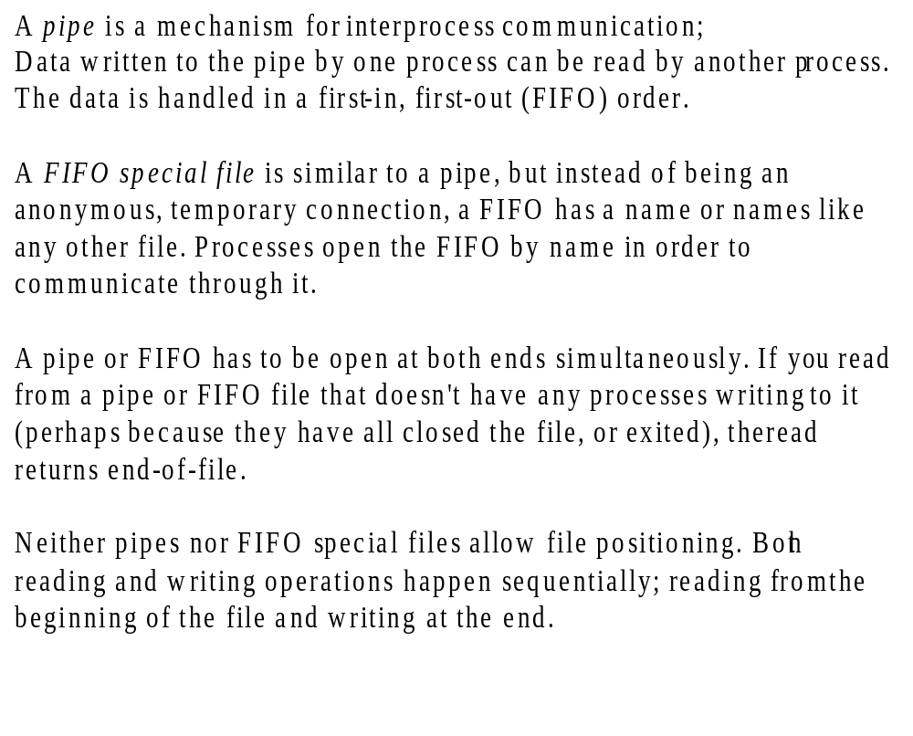

Slide 3
Anonymous Pipes:
Piping is a process where the output of one process is made the input of another.
Syntax:
FILE *popen(char *command, char *type) --
opens a pipe for I/O where the command is the process that will be connected to the calling process thus creating the pipe. The type is either ``r'' - for reading, or ``w'' for writing.
popen() returns is a stream pointer or NULL for any errors.
A pipe opened by popen() should always be closed by pclose(FILE *stream).
fprintf() and fscanf() is used to communicate with the pipe's stream

Slide 4
#include <stdio.h>
main()
{
FILE *fp;
char line[130]; /* line of data from unix command*/
fp = popen("ls -l", "r"); /* Issue the command. */
/* Read a line */
while ( fgets( line, sizeof line, fp))
{
printf("%s", line);
}
pclose(fp);
}
check .doc file for piple()

Slide 5
The primitive for creating a pipe is the pipe function.
This creates both the reading and writing ends of the pipe..
In typical use, a process creates a pipe just before it forks one or more child processes
The pipe is then used for communication either between the parent or child processes, or between two sibling processes.
The pipe function is declared in
the header file unistd.h.
— Function: int pipe (int filedes[2])
The pipe function creates a pipe and puts the file descriptors for the reading and writing ends of the pipe (respectively) into filedes[0] and filedes[1].
An easy way to remember that the input end comes first is that file descriptor 0 is standard input, and file descriptor 1 is standard output.
If successful, pipe returns a value of 0. On failure, -1 is returned.

Slide 6
int pipe(int fd[2])
Creates a pipe and returns two file descriptors, fd[0], fd[1].
fd[0] is opened for reading,
fd[1] for writing.
pipe() returns 0 on success,
1 on failure
After the pipe has been set up, two (or more) cooperative processes will be created by a fork and data will be passed using read() and write().
Pipes opened with pipe() should be closed with close(int fd).

Slide 7
Read word file

Slide 8
Named pipes, also known as fifos, have a permanent entry in the filesystem,
Any two processes can establish communication using named pipes, (provided, of course, that they agree up front on the name of the pipe).
To follow along, you'll need to open two terminal windows on your desktop.
In the first window enter the commands:
$ mkfifo foo
$ ls -l foo
Notice that the ls -l command shows foo as being of type 'p', indicating that this
entry in the filesystem is a named pipe.
$ cat foo
The cat command will open the named pipe for reading, and then block, waiting for some other process to open the pipe
for writing.
In the second terminal window, change to the same directory, and enter a
command such as:
$ echo hello > foo
In the first terminal window you should now see the string "hello" being read by
cat from the named pipe.

Slide 9
Signal()----------
Their basic function is to "get the attention" of a process when something unusual happens.
An application program can specify a function called a signal handler to be invoked when a specific signal is received. When a signal handler is invoked on receipt of a signal, it is said to catch the signal. A process can deal with a signal in one of the following ways:
•The process can let the default action happen
•The process can block the signal
(some signals cannot be ignored)
•Τhe process can catch the signal with a handler.
int (*signal(int sig, void (*func)()))()
-- that is to say the function signal() will call the func functions if the process receives a signal sig.
Refer .doc file for eg.
man 7 signal

Slide 10
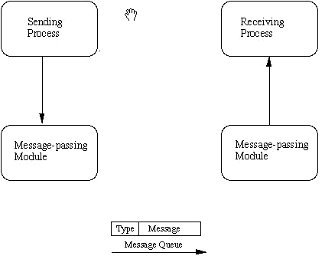
Message Queue:
Two (or more) processes can exchange information via access to a common system message queue. The sending process places via some (OS) message-passing module a message onto a queue which can be read by another process

Slide 11
The msgget() function initializes a new message queue:
int msgget(key_t key, int msgflg)
It can also return the message queue ID (msqid) of the queue corresponding to the key argument. The value passed as the msgflg argument must be an octal integer with settings for the queue's permissions and control flags.
For eg.:
key_t key = 1234;
if ((msqid = msgget(key, IPC_CREAT | 0666)) < 0)
{
perror("msgget"); exit(1);
}

Slide 12
Sending to a simple message queue:
msgsnd(msqid, msgp, msgsz, msgflg)
msqid is message queue generated
msgp is the message buffer. It is a structure having message type and an array of fixed size.
struct mymsg { long mtype; /* message type */
char mtext[MSGSZ]; /* message text of length
MSGSZ */
}
msgsz is the message size
msgflg is for synchronous/asynchronous transfer.
Refer eg. .doc file
Assignment: Write a 2 programs that will both send and messages and construct the following dialog between them
•(Process 1) Sends the message "Please hearing me?"
•(Process 2) Receives the message and replies "Yup I can hear".
•(Process 1) Receives the reply and then says "Thank you".

Slide 13
Threads
A thread is a sequence of instructions to be executed within a program.
Processes consist of a single thread of execution that starts in main().
In other words, each line of your code is executed in turn, exactly one line at a time.
Before threads, the normal way to achieve multiple instruction sequences (ie, doing several things at once, in parallel) was to use the fork() and exec() system calls to create several processes -- each being a single thread of execution.

Slide 14
Every process has the following:
a virtual address space (ie, stack, data, and code segments)
system resources
a thread of execution
Resources are private to each process;
Processes cannot peek into one another's address space
To achieve interprocess cooperation, external channels (to the process) of communication are needed.
1. writes data into a file for another process to read
2. sockets
3. pipes
4. Shared memory segments
5. Semaphores
6. Message queues

Slide 15
Advantages:
The cost of communication is negligible.
Each thread in the process sees the same virtual address space, files, etc. For eg. If one thread opens a file, it is immediately possible for all other threads to access the file.
Different parts of your code can be executed simultaneously
Disadvantages
A threaded process cannot exist across machines but on the local host
Developing a threaded program can take longer than a nonthreaded program

Slide 16
A process is allocated:
• a virtual address space to hold the process image
•control of some resources (files, I/O devices...)
A process is an execution path through one or more programs:
execution may be interleaved with other processes
•the process has an execution state
The unit of resource ownership is usually referred to as a process or task
The unit of dispatching is usually referred to a thread

Slide 17
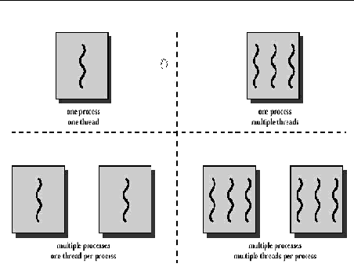

Slide 18
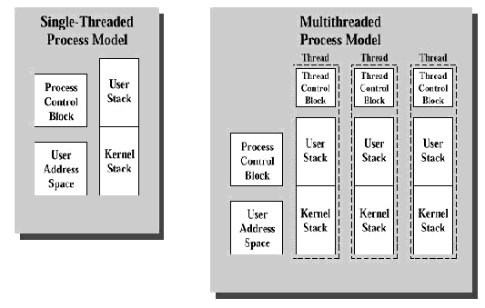

Slide 19
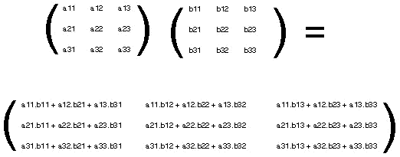
each element of the resultant matrix can be computed independently, that is to say by a different thread.

Slide 20
POSIX threads
The pthreads library is a set of C calls that provides a mechanism for writing multithreaded code. There are three major classes of calls in this library:
calls to create and destroy threads.
calls to synchronize threads and lock program resources.
calls to manage thread scheduling.
There are two kinds of threads in the pthreads library
joinable detachable
If a detached thread exits the operating systems destroys everything it allocated for that thread

Slide 21
Linux Thread Operation
pthread_create
pthread_attr_init
pthread_attr_setstacksize
pthread_attr_destroy
pthread_exit
pthread_join
pthread_attr_setdetachstate
pthread_detach
pthread_setschedparam
pthread_setschedpolicy
pthread_attr_setschedparam
pthread_attr_setschedpolicy

Slide 22
Linux uses the pthread library call pthread_create() to spawn a thread:
int pthread_create (pthread_t *thread_id, pthread_attr_t *threadAttr,void * (*start_address)(void *), void * arg);
start_address specifies the thread function i.e. is the address of the function that the newly created thread will execute.
arg is used to specify the parameter to be passed to the new thread
The stack size is set in the pthread attributes object; that is, the parameter threadAttr of type pthread_attr_t is passed to the library call pthread_create().
This object needs to be initialized by the call pthread_attr_init() before setting any attributes.
The attribute object is destroyed using the call pthread_attr_destroy()

Slide 23
When an attribute object is not specified, it is NULL, and the default thread is created with the following attributes:
•It is unbounded
•It is nondetached
•It has a a default stack and stack size
•It inherits the parent's priority
int pthread_attr_init(pthread_attr_t *threadAttr);
int pthread_attr_destroy(pthread_attr_t *threadAttr);
Refer example in thread .doc file

Slide 24
a joinable thread is a thread who's return value will be taken and analyzed by some other thread
a thread to return a value upon completion you should use the following function when you want the thread to end:
void pthread_exit(void *retval);
To read this value one of your other threads should call this function:
int pthread_join(pthread_t th, void **thread_return);
The pthread_join() function blocks the calling thread until the specified thread terminates. The specified thread must be in the current process and must not be detached. When status is not NULL, it points to a location that is set to the exit status of the terminated thread when pthread_join() returns successfully. Multiple threads cannot wait for the same thread to terminate. If they try to, one thread returns successfully and the others fail with an error of ESRCH. After pthread_join() returns, any stack storage associated with the thread can be reclaimed by the application.

Slide 25
The pthread_join() routine takes two arguments, giving some flexibility in its use. When you want the caller to wait until a specific thread terminates, supply that thread's ID as the first argument. If you are interested in the exit code of the defunct thread, supply the address of an area to receive it as the second argument .
int main ()
{
struct phonebookentry *pbe;
pthread_attr_t tattr;
pthread_t helper;
int status;
pthread_create(&helper, NULL, fetch, &pbe);
/* do something else for a while */
pthread_join(helper, &status);
/* it's now safe to use result */ }
void fetch(struct phonebookentry *arg)
{
struct phonebookentry *npbe;
/* fetch value from a database */
npbe = search (prog_name)
if (npbe != NULL)
*arg = *npbe;
pthread_exit(0);
}
struct phonebookentry {
char name[64];
char phonenumber[32];
char flags[16];
}

Slide 26
The threads library provides three synchronization mechanisms:
• mutexes - Mutual exclusion lock: Block access to variables by other threads. This enforces exclusive access by a thread to a variable or set of variables.
• joins - Make a thread wait till others are complete (terminated).
• condition variables - data type pthread_cond_t
One of the basic problems when running several threads that use the same
memory space, is making sure they don't "step on each other's toes". Can be
handled using mutex
pthread_mutex_t a_mutex = PTHREAD_MUTEX_INITIALIZER;
This type of initialization creates a mutex called 'fast mutex'. This means
that if a thread locks the mutex and then tries to lock it again, it'll get stuck.
Deadlock situation
Recursive mutex - which allows the thread that locked it, to lock it several
more times
pthread_mutex_t a_mutex = PTHREAD_RECURSIVE_MUTEX_INITIALIZER_NP;

Slide 27
Consider a GUI application which does:
One thread reads user input
Second thread handles graphical output
Third thread sends requests to a server and handles its replies.
The server-handling thread needs to be able to notify the graphics-drawing thread when a reply from the server arrived, so it will immediately show it to the user. The user-input thread needs to be always responsive to the user, for example, to allow her to cancel long operations currently executed by the server-handling thread
A condition variable is a mechanism that allows threads to wait for some event to occur.
Several threads may wait on a condition variable, until some other thread signals this condition variable (thus sending a notification).
At this time, one of the threads waiting on this condition variable wakes up, and can act on the event.
It is possible to also wake up all threads waiting on this condition variable by using a broadcast method on this variable.

Slide 28
The pthread_cond_signal() function shall unblock at least one of the threads that are blocked on the specified condition variable cond (if any threads are blocked on cond).
If one thread signals the condition variable, other threads would probably want to wait for this signal. They may do so using one of two functions, pthread_cond_wait() or pthread_cond_timedwait(). Each of these functions takes a condition variable, and a mutex (which should be locked before calling the wait function), unlocks the mutex, and waits until the condition variable is signaled, suspending the thread's execution. If this signaling causes the thread to awake , the mutex is automatically locked again by the wait funciton, and the wait function returns
For compiling and executing programs having thread functionality:
gcc -lpthread source.c -o source
gcc source.c -o source -lpthread
-lpthread loads the pthread library which we need for using threads

Slide 29
Limitation of using mutex:
A mutex is a lock that only one thread can "hold" at any given time. If a thread tries to acquire the lock while another thread "holds" it, that thread will be blocked until the lock is released. This mechanism is quite helpful when you want only one thread executing certain code at a given time
Imagine a situation where you have multiple resources that are being used concurrently

Slide 30
Problem:
You call a ticket agent to buy a plane ticket.
All the ticket agents are serving other customers when you call.
You will be put on hold until "the next available ticket agent" can take your call.
Condition:
Somehow, the resources (ticket agents) must be distributed to the consumers in such a way that all ticket agents are taking calls and no ticket agent is assigned more than one customer at a time.
Issue:
If you try to solve this problem using only mutexes, you will probably have great difficulty.
Is there any better way to solve this type of problem?

Slide 31
Semaphores
Semaphores are used to control access to shared resources by processes..
A "semaphore" is a counter that can be used to keep track of resources in threaded applications
The value of the semaphore can be thought of as the number of unused resources
Represents a non-negative value that can be signaled or waited on
If a thread signals a semaphore, the value of the semaphore increases by one
If a thread waits on a semaphore, two things can happen
If the value of the semaphore is greater than zero, that value is decreased
by one, and the call to wait returns
if the value of the semaphore is zero, the thread that waited on it is blocked
until the value is greater than zero
When this number reaches zero, a thread that wishes to use a resource must wait until one is available
#include <semaphore.h>
sem_t my_semaphore; //declared a semaphore.

Slide 32
The value of the semaphore is initialized to the number of equivalent shared resources it is implemented to control.
In the special case where there is a single equivalent shared resource, the semaphore is called a binary semaphore.
The general case semaphore is often called a counting semaphore.
The value of a semaphore is the number of units of the resource which are free. (If there is only one resource, a "binary semaphore" with values 0 or 1 is used.)
The P operation busy-waits (or maybe sleeps) until a resource is available, whereupon it immediately claims one.
V is the inverse; it simply makes a resource available again after the process has finished using it.
Init is only used to initialize the semaphore before any requests are made. The P and V operations must be atomic, which means that no process may ever be preempted in the middle of one of those operations to run another operation on the same semaphore.

Slide 33
Consider this example:
We have a thread A that needs information from two databases, before it can proceed. Access to these databases is controlled by two separate threads B, C. These two threads have a message-processing loop; anybody needing their services posts a message into their message queue. Thread A initializes a semaphore S with init(S,-1). A then posts a data request, including a pointer to the semaphore S, to both B and C. Then A calls P(S), which blocks. The other two threads meanwhile take their time obtaining the information; when each thread finishes obtaining the information, it calls V(S) on the passed semaphore. Only after both threads have completed, the semaphore's value will become positive and A be able to continue. A semaphore used in this way is called a "counting semaphore."

Slide 34
Barber's Shop Problem:
    The analogy is based upon a hypothetical barber shop with one barber, one barber chair, and a number of chairs for waiting customers. When there are no customers, the barber sits in his chair and sleeps. As soon as a customer arrives, he either awakens the barber or, if the barber is cutting someone else's hair, sits down in one of the vacant chairs. If all of the chairs are occupied, the newly arrived customer simply leaves.
The most common solution involves using three semaphores: one for any waiting customers, one for the barber (to see if he is idle), and a mutex. When a customer arrives, he attempts to acquire the mutex, and waits until he has succeeded. The customer then checks to see if there is an empty chair for him (either one in the waiting room or the barber chair), and if none of these are empty, leaves. Otherwise the customer takes a seat – thus reducing the number available (a critical section). The customer then signals the barber to awaken through his semaphore, and the mutex is released to allow other customers (or the barber) the ability to acquire it. If the barber is not free, the customer then waits. The barber sits in a perpetual waiting loop, being awakened by any waiting customers. Once he is awoken, he signals the waiting customers through their semaphore, allowing them to get their hair cut one at a time.

Slide 35
+ Semaphore Customers
+ Semaphore Barber
+ Semaphore accessSeats (mutex)
+ int NumberOfFreeSeats
while(true) //runs in an infinite loop
{ Customers.p() //tries to acquire a customer - if none is available he goes to sleep
accessSeats.p() //at this time he has been awaken -> want to modify the number of available seats
NumberOfFreeSeats++ //one chair gets free
Barber.v() // the barber is ready to cut
accessSeats.v() //we don't need the lock on the chairs anymore
//here the barber is cutting hair
}

Slide 36
The semaphore lock operation checks to see if the resource is available or is locked by another process.
If the semaphore's value is a positive number, the lock is made, the semaphore value is decremented, and the process continues execution.
If the semaphore's value is zero or a negative number, the process requesting the lock waits (is blocked) until another process unlocks the resource. Several processes may be blocked waiting for a resource to become available.
The semaphore unlock operation increments the semaphore value to indicate that the resource is not locked. A waiting process, if there is one, is unblocked and it accesses the resource. Each semaphore keeps count of the number of processes waiting for access to the resource.

Slide 37
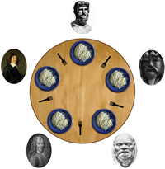
There is a dining table with a large bowl of spaghetti in the center of the table. There are five plates at the table and five forks set between the plates. Eating the spaghetti requires the use of two forks which the diner pick up one at a time.
Q. What happens if all pick up the left fork?
Q. What happens if the diner pick up the forks in increasing order

Slide 38
The sem_init() function
Initializes an unnamed semaphore and sets its initial value.
int sem_init(sem_t * sem, int shared, unsigned int value);
sem
A pointer to the storage of an uninitialized unnamed semaphore.
The pointer must be aligned on a 16-byte boundary.
shared
An indication to the system of how the semaphore is going to be used.
if zero it indicates that the semaphore will be used only by threads within the current process.
Else if nonzero value it indicates that the semaphore may be used by threads
from other processes.
value
The value used to initialize the value of the semaphore.

Slide 39
int sem_destroy(sem_t * sem);
destroys an unnamed semaphore that was previously initialized using sem_init()
int sem_getvalue(sem_t * sem, int * value);
retrieves the value of a named or unnamed semaphore. If the current value of the semaphore is zero and there are threads waiting on the semaphore, a negative value is returned. The absolute value of this negative value is the number of threads waiting on the semaphore.
int sem_post(sem_t * sem);
posts to a semaphore, incrementing its value by one. If the resulting value is greater than zero and if there is a thread waiting on the semaphore, the waiting thread decrements the semaphore value by one and continues running.
int sem_wait(sem_t * sem);
The sem_wait() function decrements by one the value of the semaphore. The semaphore will be decremented when its value is greater than zero. If the value of the semaphore is zero, then the current thread will block until the semaphore's value becomes greater than zero.

Slide 40
Function Description
sem_close Deallocates the specified named semaphore
sem_destroy Destroys an unnamed semaphore
sem_getvalue Gets the value of a specified semaphore
sem_init Initializes an unnamed semaphore
sem_open Opens/creates a named semaphore for use by a
process
sem_post Unlocks a locked semaphore
sem_trywait Performs a semaphore lock on a semaphore
only if it can lock the semaphore without
waiting for another process to unlock it
sem_unlink Removes a specified named semaphore
sem_wait Performs a semaphore lock on a semaphore

Slide 41
#include <semaphore.h>
main()
{
sem_t my_semaphore;
int rc;
rc = sem_init(&my_semaphore, 0, 10);
}
my_semaphore, that will be used by threads of the current process. Its value is set to 10(presumed there are 10 unused resources).
#include <semaphore.h>
main() {
sem_t my_semaphore;
int rc;
rc = sem_init(&my_semaphore, 0, 10);
rc = sem_destroy(&my_semaphore);
}

Slide 42
#include <stdio.h>
#include <semaphore.h>
main()
{
sem_t my_semaphore;
int value;
sem_init(&my_semaphore, 0, 1);
sem_getvalue(&my_semaphore, &value);
printf("The initial value of the semaphore is %d\n", value);
sem_wait(&my_semaphore);
sem_getvalue(&my_semaphore, &value);
printf("The value of the semaphore after the wait is %d\n",value);
}
The initial value of the semaphore is 1
The value of the semaphore after the wait is 0

Slide 43
#include<error.h>
main() {
sem_t my_semaphore;
int value;
int rc;
sem_init(&my_semaphore, 0, 1);
sem_getvalue(&my_semaphore, &value);
printf("The initial value of the semaphore is %d\n", value);
sem_wait(&my_semaphore);
sem_getvalue(&my_semaphore, &value);
printf("The value of the semaphore after the wait is%d\n",value);
rc = sem_trywait(&my_semaphore);
if ((rc == -1) && (errno == EAGAIN))
{
printf("sem_trywait did not decrement the semaphore\n");
}
}
Output:
The initial value of the semaphore is 1
The value of the semaphore after the wait is 0
sem_trywait did not decrement the semaphore

Slide 44
include <semaphore.h>
main() { sem_t * my_semaphore;
int rc;
my_semaphore = sem_open("/mysemaphore", O_CREAT, S_IRUSR | S_IWUSR, 10);
}
example opens the named semaphore "/mysemaphore" and creates the semaphore with an initial value of 10 if it does not already exist
#include <semaphore.h>
main() {
sem_t * my_semaphore;
int rc;
my_semaphore = sem_open("/mysemaphore",
O_CREAT, S_IRUSR | S_IWUSR,
10);
sem_close(my_semaphore);
}
opens a named semaphore with an initial value of 10 and then closes it

Slide 45
Declare the semaphore global (outside of any funcion):
sem_t mutex;
Initialize the semaphore in the main function:
sem_init(&mutex, 0, 1);
Thread 1 Thread 2 data
sem_wait (&mutex); --- 0
--- sem_wait (&mutex); 0
a = data; /* blocked */ 0
a = a+1; /* blocked */ 0
data = a; /* blocked */ 1
sem_post (&mutex); /* blocked */ 1
/* blocked */ b = data; 1
/* blocked */ b = b + 1; 1
/* blocked */ data = b; 2
/* blocked */ sem_post (&mutex); 2

Slide 47
Using locks, semaphores and condition variables:
Construct a program that can:
1) handle callers and distribute them to ticket agents without allocating two callers to any agent simultaneously
2) have all ticket agents responding to calls when there are customers waiting to buy tickets
3) assure that only the total number of tickets available are sold
4) notify a bookkeeper that will perform certain actions once all the tickets are sold (and not before).

